Slide 1
Simulating Generalized Ground Multi-Agent Robotic Search Informed by Graph Neural Networks
Rishabh Kumaran, Rocco Zhang
5/21/25
Computer Systems Lab - Yilmaz Pd. 1, 3
Notes:
Rishabh

Slide 2
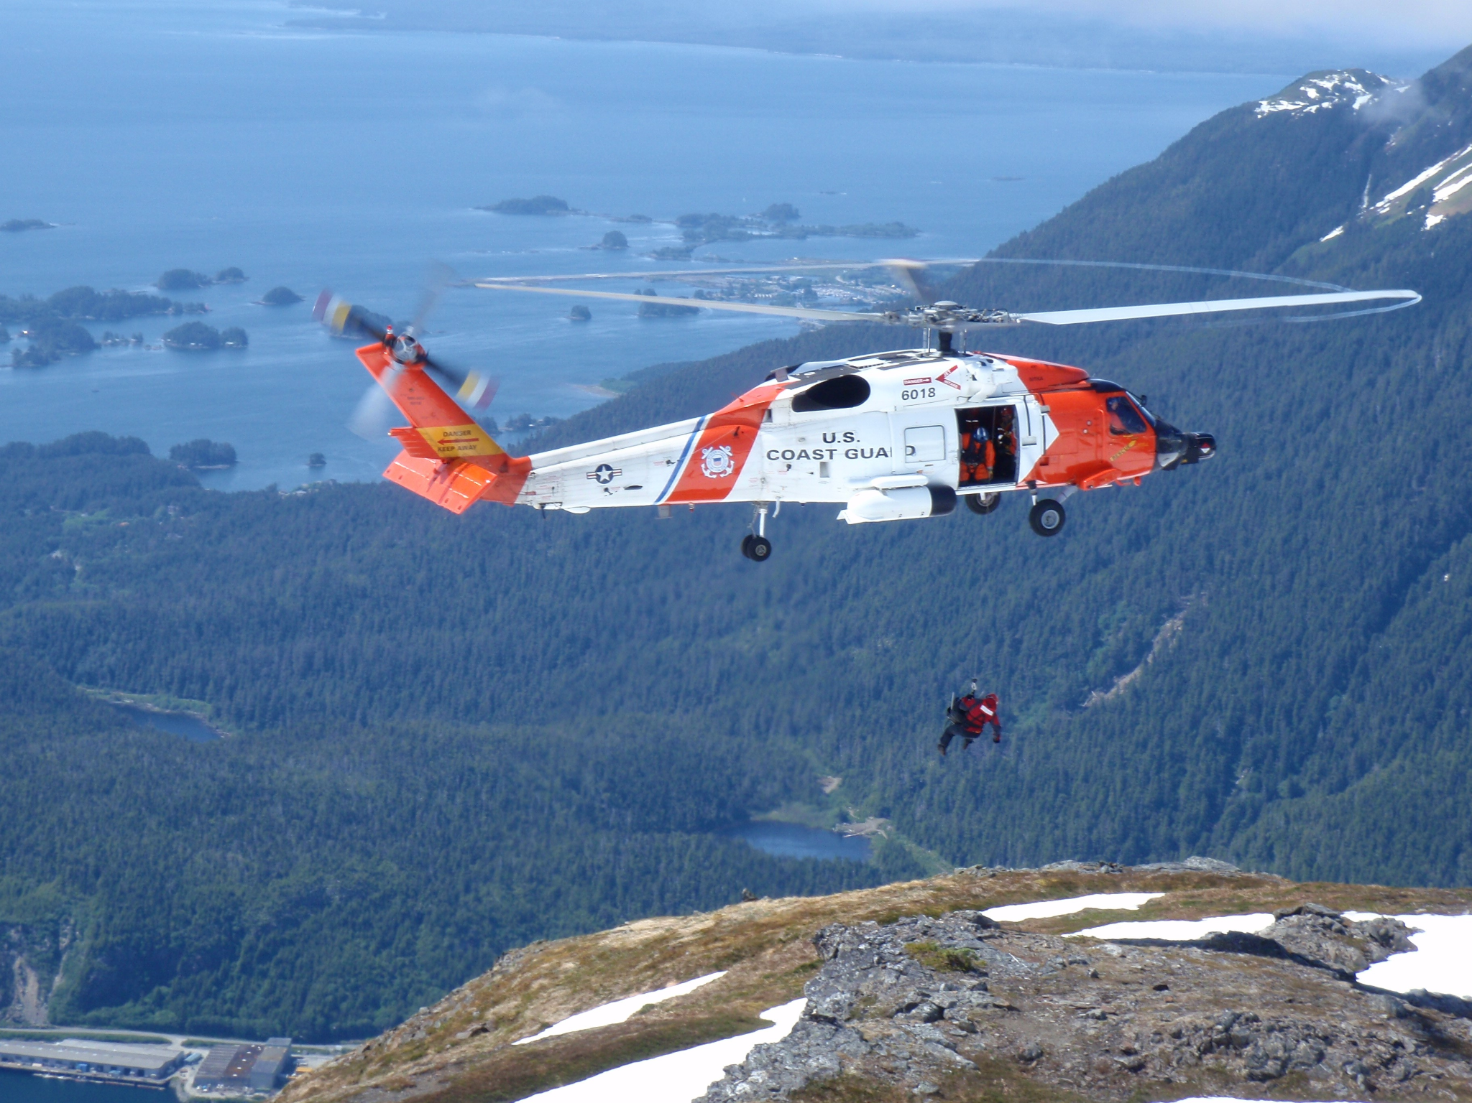
The Problem
Search and rescue operations can often:
Be slow and tedious
Incur high costs in equipment, time and other resources
Result in failure due to human error or insufficient time
Survival rate drops to 20% after 72 hours [1]
Figure 1. U.S. Coast Guard MH-60 Jayhawk helicopter conducting a mountain rescue. (U.S. Coast Guard, n.d.)
Notes:
Rishabh

Slide 3
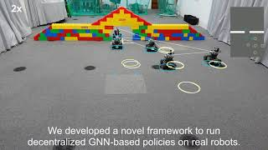
Background
Multi-agent robotic systems have a wide range of applications:
Warehouse management
Autonomous driving
Terrain search (and rescue)
Typically relies on reinforcement learning (RL), but the RL algorithm, centralization, and communication methods can vary.
(Prorok Lab, 2021)
Notes:
Rocco

Slide 4
Other Solutions
Using an approach based on floodfill
Ineffective due to multiple agents
More effective in structured environments like a maze
Other Reinforcement Learning algorithms
Deep Q-Network
Requires discrete action space
Advantage Actor-Critic
Shown to have worse performance than MAPPO [4]
Notes:
Rishabh

Slide 5
Why is Ours Better?
Ground-based search allows for more thorough search than drones, yet greater speed and accuracy than human teams
Utilizing multiple agents maximizes efficiency and decentralized communication reduces dependencies and vulnerabilities
Multi-agent Reinforcement Learning algorithm enhanced by GNNs should improve performance
Algorithm is scalable to any number of robots, any environment dimensions, and any number of obstacles
Notes:
Rocco

Slide 6
Impact
Improvement in search and rescue missions that could save lives in the aftermath of a natural disaster
Other possible applications such as locating object in inventory or organization for convenience
Improves the current field of research of coordinating multiple robots
Notes:
Rishabh

Slide 7
Methods - Reinforcement Learning
Agents interact with environment through actions
Actions result in reward/punishment
Actions are determined by rewards and current observations
Optical camera
LiDAR scanner
Shared messages
Policy determines what action should be taken at each time step
Notes:
Rishabh

Slide 8
Methods - MARL
Multi-Agent Reinforcement Learning adds another layer of complexity
Cooperation vs Competition (in this case, cooperation)
MARL encourages coordinated behaviors through
Interactions between agents (messages)
Individual vs global rewards
Multiple different approaches for training
Notes:
Rishabh

Slide 9
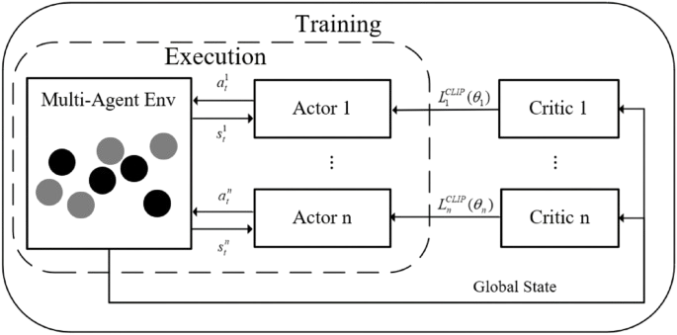
Methods - MAPPO
MAPPO - Multi-Agent Proximal Policy Optimization
Centralized training with decentralized execution
Each agent has individual policy
Shared critic
The critic estimates average total reward for an agent
Used to compute advantage, determining how good an action was
Figure 2. Diagram of MAPPO training architecture
Notes:
Rishabh

Slide 10
Methods - GNNs
A graph represents the relationship between agents
Nodes represent the agents
Edges represent communication links, determined by the communication range
Node features include the observations (position, LiDAR etc.)
GNN updates each node’s features based on the neighbors
One shared GNN policy computes actions for each agent
Notes:
Rocco

Slide 11
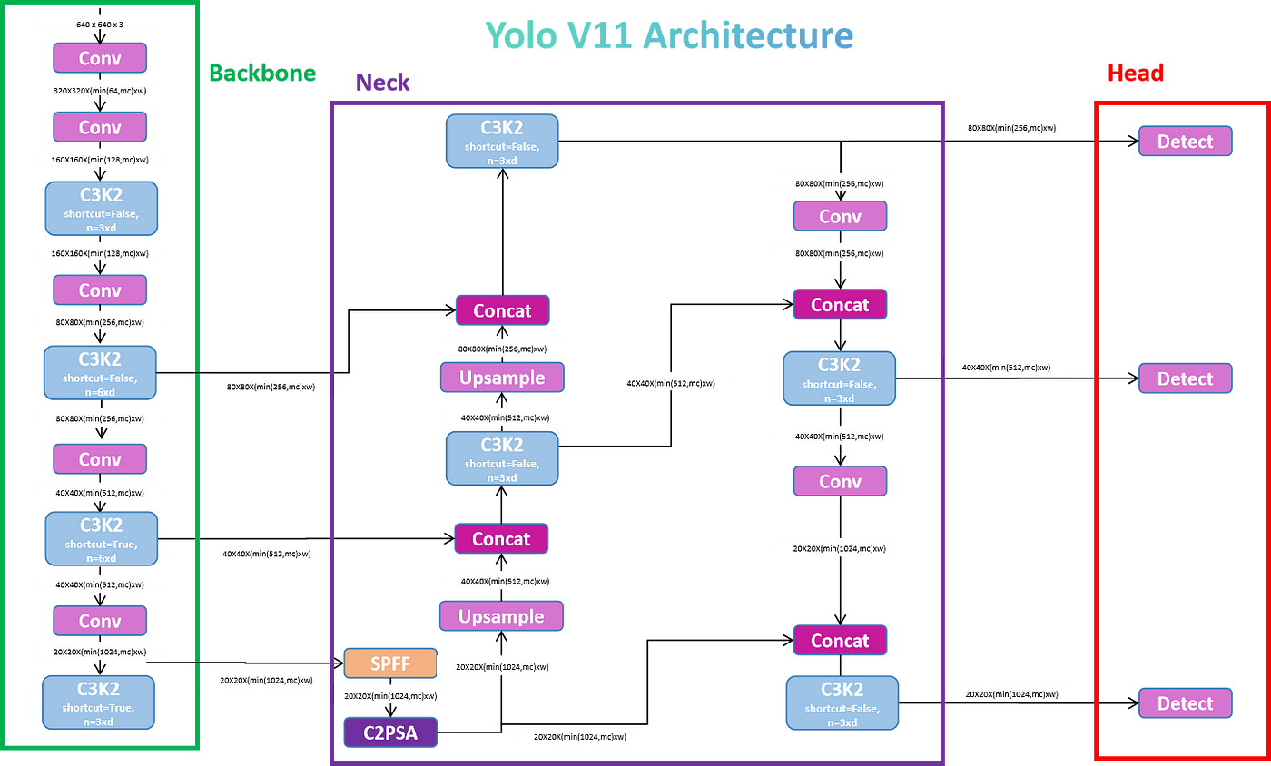
Methods - YOLOv11
Fast, real-time object detection model
Relies on CNN backbone to process image
Predicts bounding box, objectness score, and class probabilities
Figure 3. In-depth diagram depicting the architecture of YOLOv11
Notes:
Rocco

Slide 12
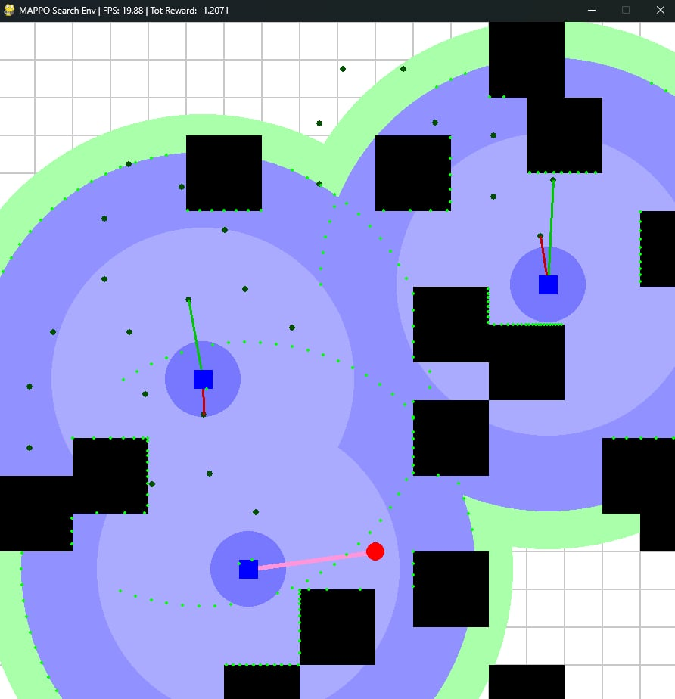
Methods - Environment Simulation
Implemented through the Petting Zoo library
Rendered using the Pygame library
Treated as 2D plane
Other parameters include
# of agents
LiDAR radius
Optical camera radius
Success range
# of obstacles and dimensions
Dimensions of the environment
Figure 4. Example of how the environment looks after rendering
Notes:
Rishabh

Slide 13
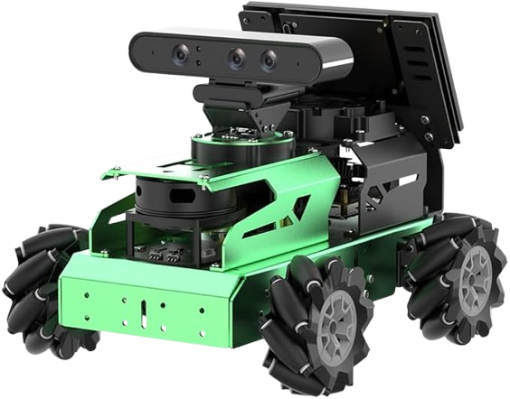
Methods - Agent (HiWonder JetAuto)
Stereo (Depth) Camera
target detection
target localization
360º LiDAR
distance sensor
obstacle avoidance
On-board Computer
NVIDIA Jetson Nano (GPU)
ARM Cortex-A57 (CPU)
Wireless transmitter/receiver
Mecanum Wheel Drive
omnidirectional
Figure 5. Capabilities of HiWonder JetAuto
Notes:
Rocco

Slide 14
Methods - Systems Architecture
Drive Direction
(Omni-drivetrain)
Agent N
Environment
Neighbor Message
(Transmitter)
.
.
Depth Camera
MARL Framework
Agent 2
GNN
YOLOv11
LiDAR
Jetson Nano
Agent 1
Robot
Notes:
Rocco

Slide 15
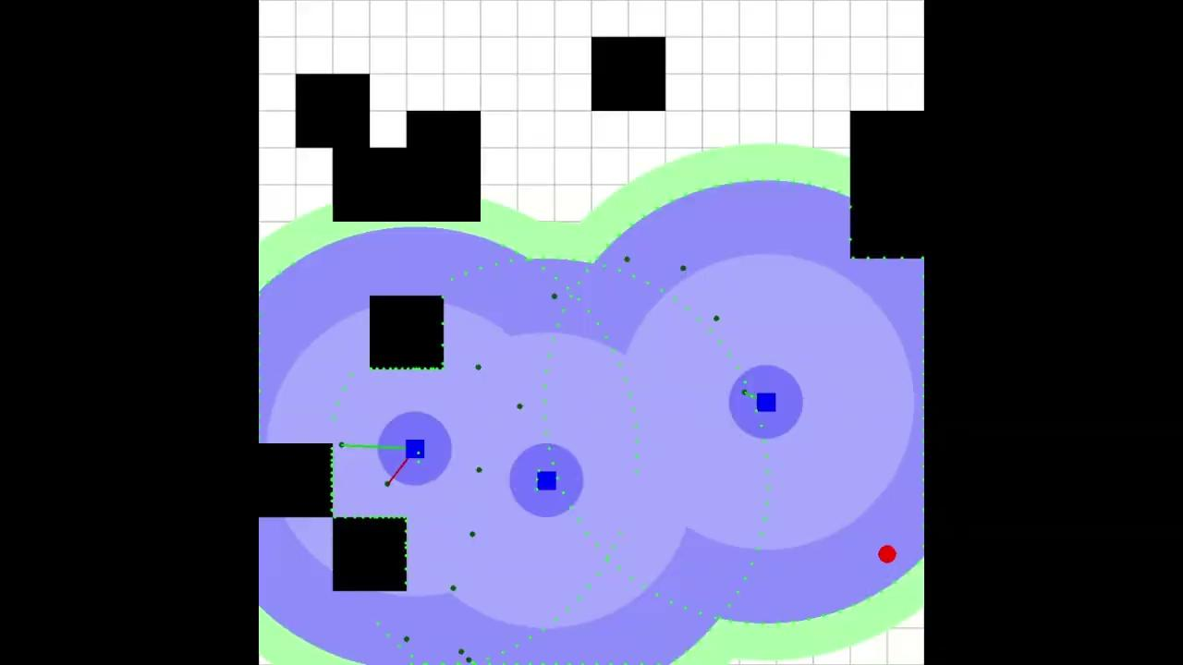
Demonstration - RL Model
Notes:
Rocco

Slide 16
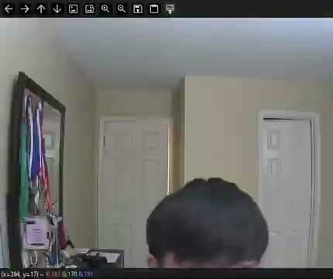
Demonstration - YOLO Model
Notes:
Rocco

Slide 17
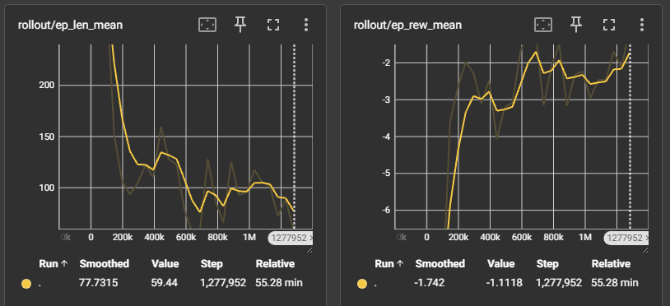
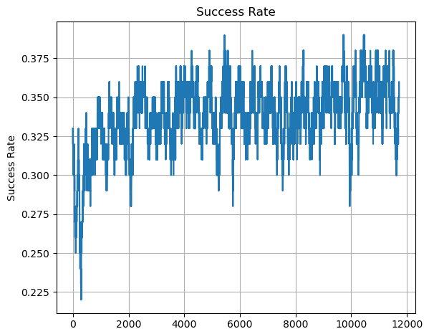
Results
End model averages 59.4 steps per simulation, down from starting ~300 steps
~40% faster than a deterministic search algorithm like floodfill
Generalizable to more agents, larger environment, and greater number of obstacles
Figure 6. Graphs of the average steps and reward throughout training
Figure 7. Graph of the success rate throughout training
Notes:
Rocco

Slide 18

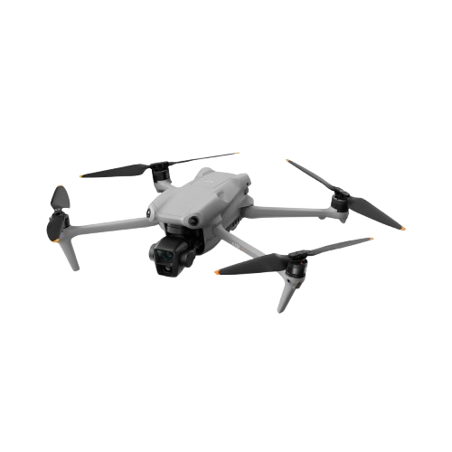
Application
Target
Notes:
Rocco

Slide 19
Challenge - Corrupted Environment
Purchased two JetAutos
Runs on ROS (Robot Operating Software [version Melodic]), a middleware between programs and hardware drivers. This has been implemented in Ubuntu from the manufacturer.
To “start” the robot, roslaunch needs to be called
Robot A: Corruption of ROS files led us to reinstall Python and ROS, but roslaunch runs into an error when launching one of the nodes, rosout1
Robot B: Running roslaunch freezes after the step of “imu calibration”. We believe it came like this out of the box, and resolution requires understanding the manufacturer’s ROS system.
Notes:
Rocco

Slide 20
Limitations
Only operating in 2-dimensional space
Simulated environment is still not completely realistic
Obstacles may very
Target detection might be more complicated
Limitations on computational resources
Unable to physically test our algorithm
Notes:
Rishabh

Slide 21
Conclusion & Future Work
Successfully developed a novel Multi-Agent Reinforcement Learning algorithm for searching, while using Graph Neural Networks and simulated LiDAR scans to maximize ground-based search efficiency.
Future Ideas:
Work on incorporating the 3rd dimension
Utilizing optical camera outside of target detection
Investigating Value-Decomposition Network Algorithms
Notes:
Rishabh

Slide 22
References
[1] Amini, M., Kachitvichyanukul, V., & Sirivipanich, V. (2022). Application of Soft Systems Methodology in solving disaster emergency logistics problems. International Journal of the Analytic Hierarchy Process, 14(1), 1–20. https://doi.org/10.13033/ijahp.v14i1.1050
[2] U.S. Forest Service. (n.d.). Search and rescue team asks people to prepare for anything when headed outdoors [Photograph]. U.S. Department of Agriculture. https://www.fs.usda.gov/about-agency/features/search-and-rescue-team-asks-people-prepare-anything-when-headed-outdoors
[3] Prorok Lab. (2021, November 3). A Framework for Real-World Multi-Robot Systems Running Decentralized GNN-Based Policies [Video]. YouTube. https://www.youtube.com/watch?v=COh-WLn4iO4

Slide 23
References (cont.)
[4] Abdulghani, A. M., Abdulghani, M. M., Walters, W. L., & Abed, K. H. (2024). Performance evaluation of multi-agent reinforcement learning algorithms. Intelligent Automation & Soft Computing, 39(2), 338–352. https://doi.org/10.32604/iasc.2024.047017
[5] Rao, S. N. (2024, October 22). YOLOv11 explained: Next-level object detection with enhanced speed and accuracy. Medium. https://medium.com/@nikhil-rao-20/yolov11-explained-next-level-object-detection-with-enhanced-speed-and-accuracy-2dbe2d376f71

Slide 24
Thanks!
Any Questions?

